Slide 1
Production Audit
J V Industries Presentation
By Krishna Agrawal
Data Analyst
Presented on 11-06-2026

Slide 2
Introduction
Information based on sample data | Figures
Total number of machines checked | 55 Machines
No. of Machine Types | 4 Machine Types
Average no. of Parts Produced | 244.9 Parts produced per Machine
Average of Downtime Minutes | ~24 Minutes per Machine
Average no. of Defective Parts | ~11 Parts per Machine

Slide 3
Observed Issues
Query | Figures
Errors found in the dataset | 3 Operators forgot to punch their Downtime Minutes 2 Typing errors
No. of major stops | 14 machines
Which Machine Type bleed the most money | Stamping Press Machine broke 54 parts

Slide 4
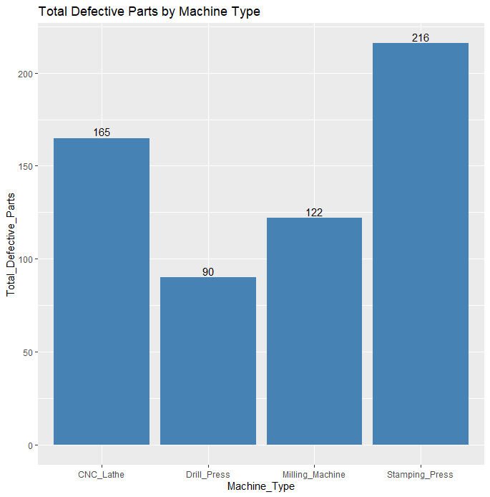
Chart showing the Total Defective Parts by Machine Type.

